Slide 1

Chapter 2 – S2
Getting started with JavaScript
Notes:
Session: Ghi số thứ tự session trong môn học
Session Name: ghi tên của session sẽ dạy

Slide 2
Objectives
How to include JavaScript in an HTML document
The JavaScript syntax
How to use objects, methods, and properties
How to work with JavaScript data
Two illustrative application
Notes:
Mô tả nội dung mà học viên phải đạt được khi kết thúc môn học này

Slide 3
How to include JavaScript
in an HTML document
Notes:
Session: Ghi số thứ tự session trong môn học
Session Name: ghi tên của session sẽ dạy

Slide 4
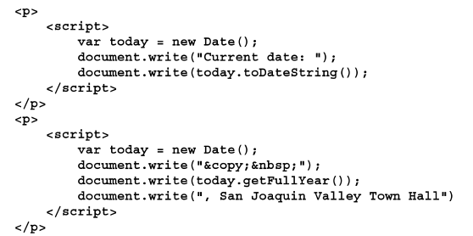
JavaScript example
JavaScript in HTML document

Slide 5
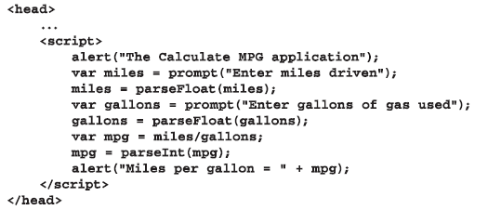
Three ways to include JavaScript in a web page
A script element in the head section that loads an external JavaScript
A script element that embedded JavaScripts in the head section

Slide 6
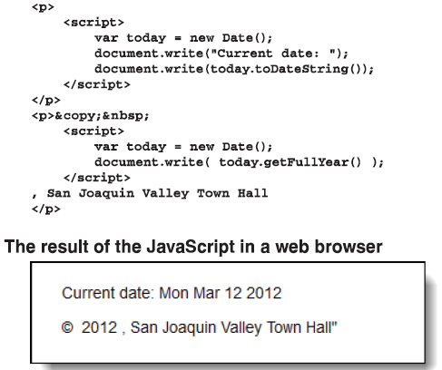
Three ways to include JavaScript in a web page (cont.)
A script element that embedded JavaScripts in the body section

Slide 7
The JavaScript syntax
Notes:
Session: Ghi số thứ tự session trong môn học
Session Name: ghi tên của session sẽ dạy

Slide 8
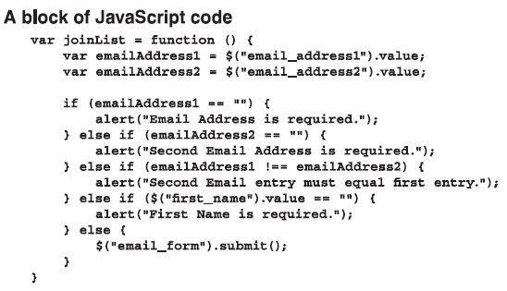
How to code JavaScript statements
Syntax:
Var function_name = function(){
statements;
}

Slide 9
How to code JavaScript statements
A JavaScript statements has a syntax that’s similar to the syntax of Java
The basic syntax rules:
JavaScript is case-sensitive
Each JavaScript statement ends with a semicolon.
JavaScript ignores extra whitespace within statements

Slide 10
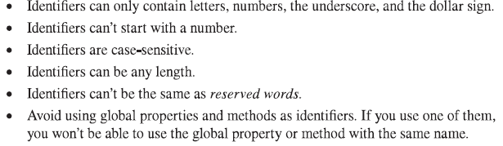
How to create identifiers
Identifiers are the name given to variables, functions, objects, properties and methods.
Rules for creating identifiers

Slide 11
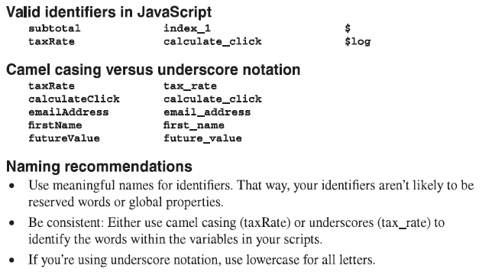
How to create identifiers (cont.)

Slide 12
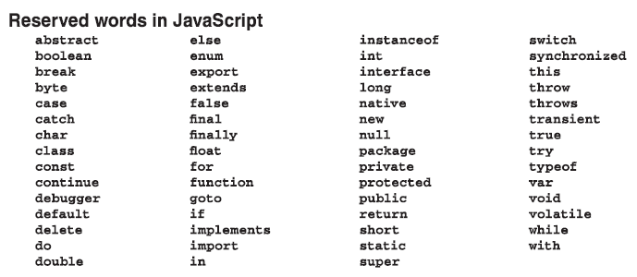
How to create identifiers (cont.)
You can’t create an identifier with a reserved words.

Slide 13
How to use comments
Comments let you add descriptive notes to your code.
Comments are ignored when JavaScript is executed.
JavaScripts provides two forms of comments:
Single line comment:
//This is single line comement
Block comment:
/* This is
Block comment */

Slide 14
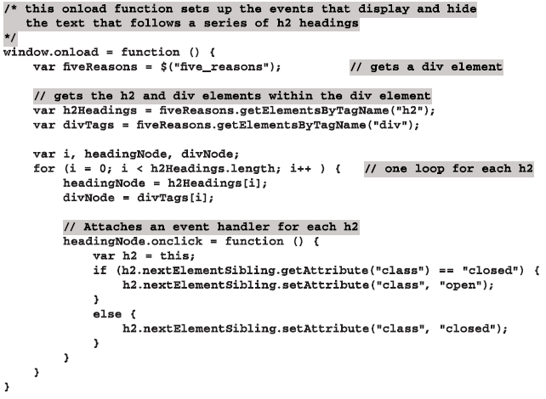
How to use comments (cont.)

Slide 15
How to use objects, methods,
and properties
Notes:
Session: Ghi số thứ tự session trong môn học
Session Name: ghi tên của session sẽ dạy

Slide 16
Introduction to object, methods, and properties
Object is a collection of methods and properties.
A method performs a function or does an action.
A property is a data item that relates to the object.
The window object is a global object for JavaScript.

Slide 17
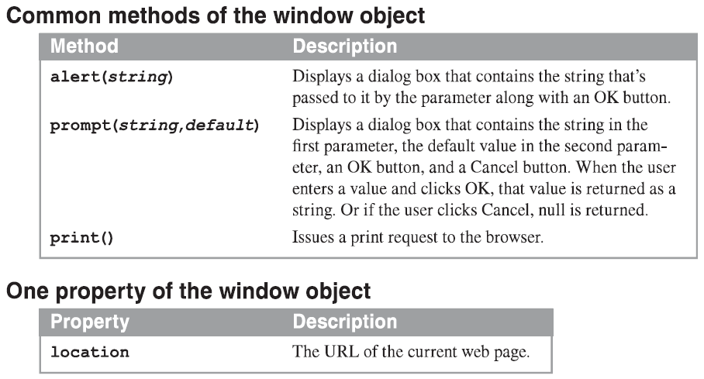
Introduction to object, methods, and properties (cont.)

Slide 18
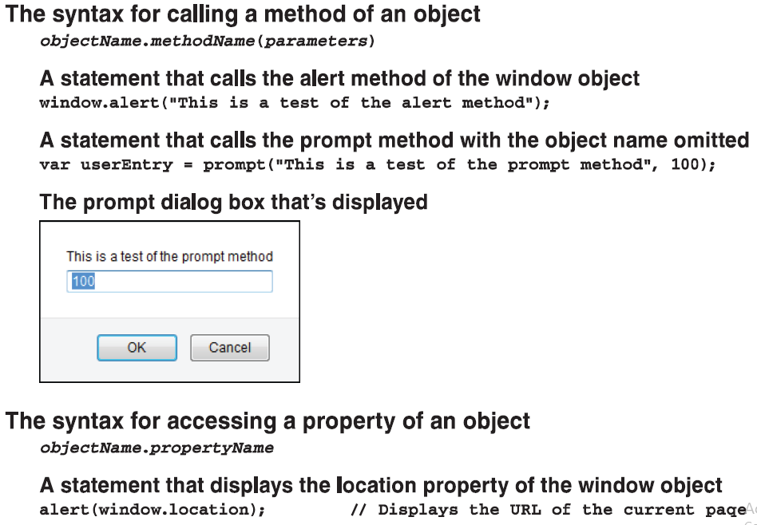
Introduction to object, methods, and properties (cont.)

Slide 19
How to use the write() and writelin() method of the document object
Method | Description
write(string) | Writes the string that’s passed to it into the document.
writeln(string) | Writes the string that’s passed to it into the document ending with a new line character.

Slide 20
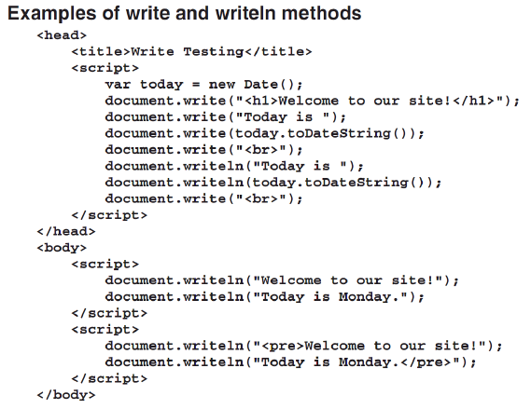
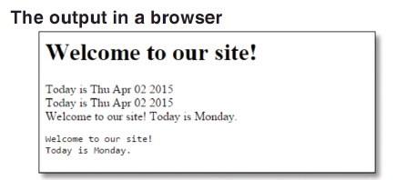
How to use the write() and writelin() method of the document object (cont.)

Slide 21
How to work with JavaScript data
Notes:
Session: Ghi số thứ tự session trong môn học
Session Name: ghi tên của session sẽ dạy

Slide 22
The primitive data types
Date type decide what type of data will store in a variable.
Javascript’s primitive data types
Data type | Description
Number | Represents an integer or a decimal value that can start with a positive or negative sign.
String | Represents character (string) data.
Boolean | Represents a Boolean value that has two possible state true or false.

Slide 23
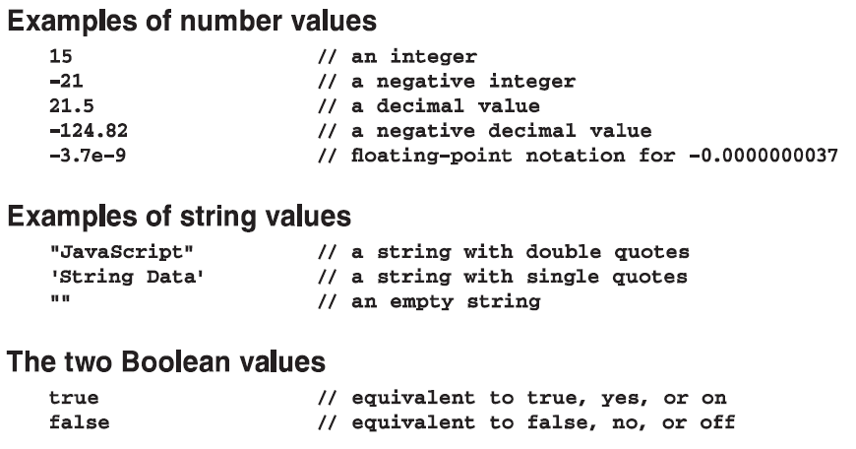
The primitive data types (cont.)

Slide 24
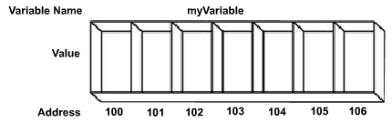
How to use variables
A variable is a location in the computer’s memory is stored and retrieved later

Slide 25
How to use variables
Syntax to declare and assign value to a variable
var variableName;
variableName = value;
Examples
var counter;
counter = 1;
var sum, average;
sum = 0; average = 0;

Slide 26
How to use variables (cont.)
Syntax to declare and assign value to a variable in one statement
var variableName = value;
Examples
var counter = 1;
var subtotal = 74.95;
var name = “Joshep”;
var isValid = false;

Slide 27
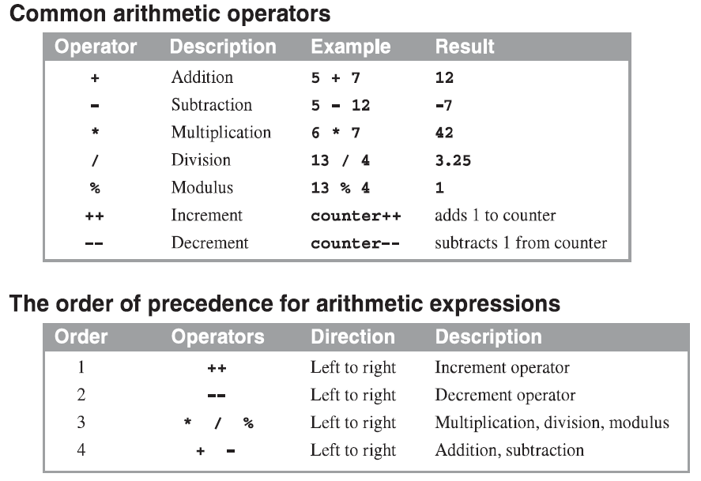
How to code arithmetic expressions

Slide 28
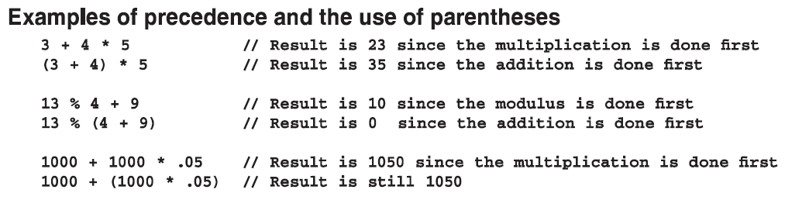
How to code arithmetic expressions (cont.)

Slide 29
How to use arithmetic expressions in assignment statements
Code that calculates sale tax
var subtotal = 200;
var taxPercent = .5;
var taxAmount = subtotal * taxPercent;
var total = subtotal + taxAmount;

Slide 30
How to use arithmetic expressions in assignment statements (cont.)
The most useful compound assignment operators
Statements that use the compound assignment operators
var subtotal = 74.95;
Subtotal += 20.00;
var counter = 10;
counter -= 1;
var price = 100;
price *= .8;
Operator | Description
+= | Adds the result of the expression to the variable.
-= | Subtracts the result of the expression from the variable.
*= | Multiplies the variable value by the result of the expression.

Slide 31
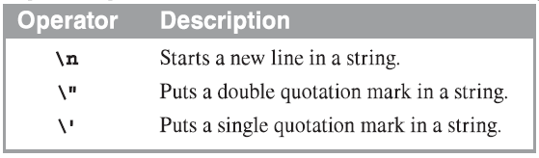
How to work with strings variable
The concatenation operators for strings
Some of the escape sequences that can be used in strings
Operator | Description
+ | Concatenates two values.
+= | Adds the result of the expression to the end of the variable

Slide 32
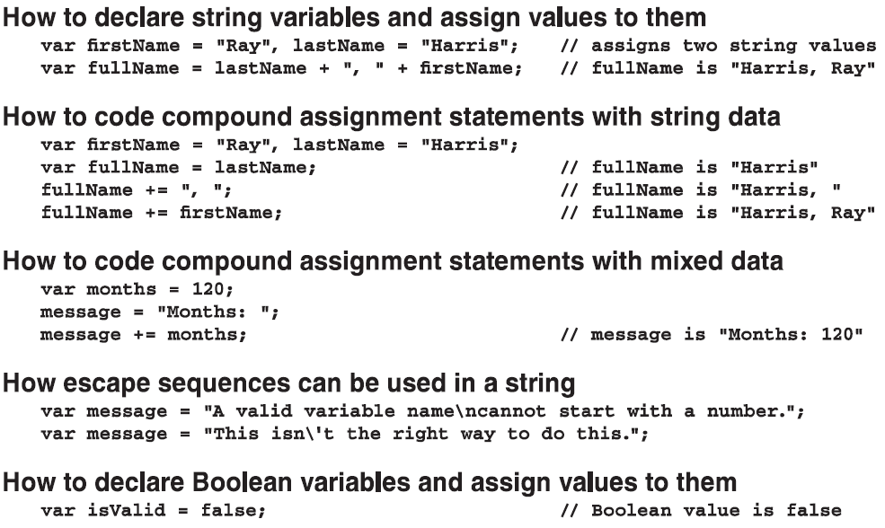
How to work with strings variable (cont.)

Slide 33
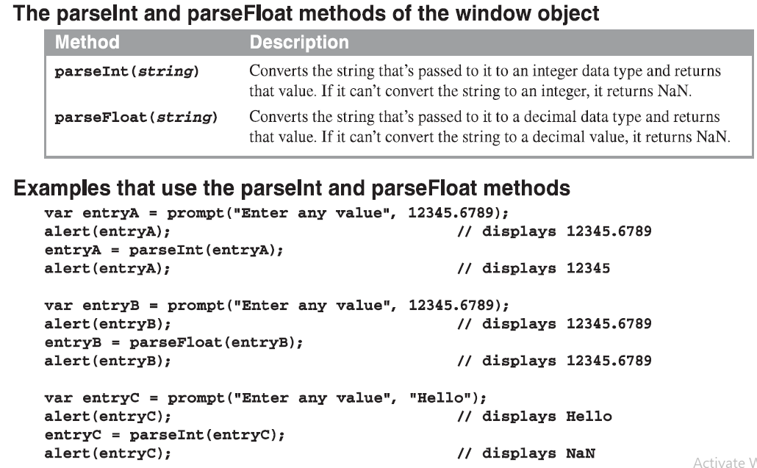
How to use the parseInt() and parseFloat() method

Slide 34
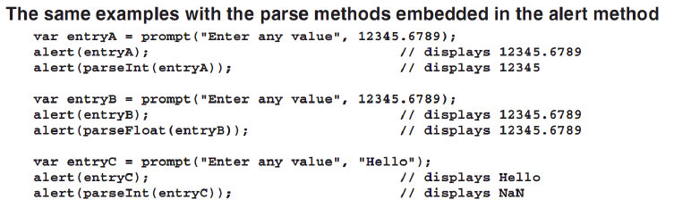
How to use the parseInt() and parseFloat() method – cont.

Slide 35
Two illustrative applications
Notes:
Session: Ghi số thứ tự session trong môn học
Session Name: ghi tên của session sẽ dạy

Slide 36
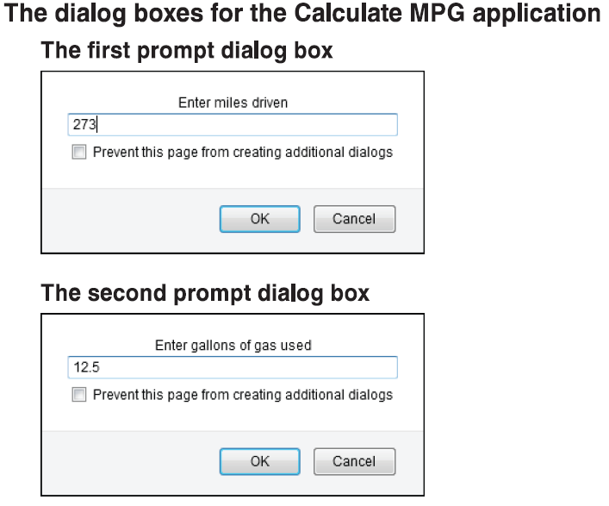
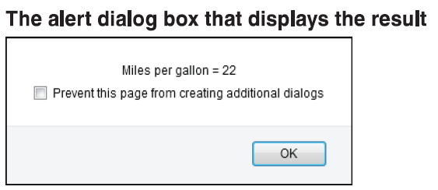
The Miles Per Gallan application

Slide 37
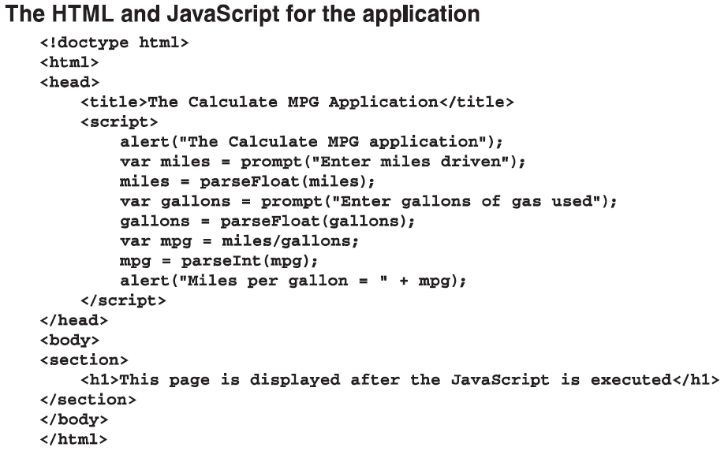
The Miles Per Gallan application (cont)
Notes:
average

Slide 38
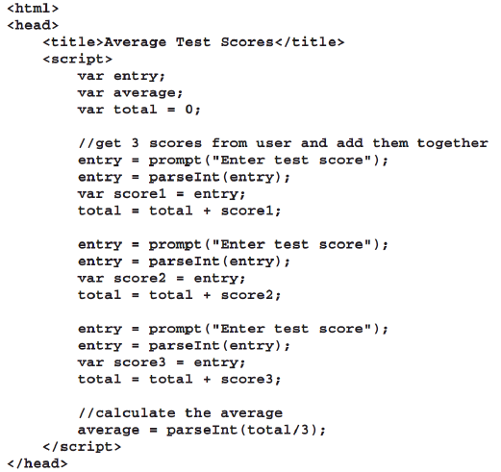
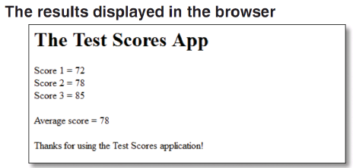
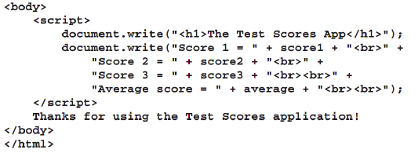
The Test Scores application

Slide 39
Summary
There are three ways to include JavaScript in a web page: external scripts, embedded in head section and embedded in body section.
A JavaScript statements has a syntax that’s similar to the syntax of Java.
Javascript’s primitive data types: Number, String, Boolean.
A variable is a location in the computer’s memory is stored and retrieved later.
Object is a collection of methods and properties.
A method performs a function or does an action.
A property is a data item that relates to the object.
The window object is a global object for JavaScript.
Notes:
Tóm tắt lại nội dung đã học

Slide 40
Assignment
Do the excecise 2-3 on the book.

